Slide 1
CSUF Campus Garden Planning
May 25, 2022

Slide 2
Agenda
Overview
Phase One
Organization for implementation
Installation
Bed shepherding process
Phase Two
Expansion
Fundraising
Action items

Slide 3
Mission
Provide learning opportunities to the campus and greater communities on a variety of garden topics, including:
How to grow foods
Exploratory hands-on learning
Farm-to-table concepts
Nutrition and wellness
Composting
Food access
Sustainability

Slide 4
Participating groups
CSUF Center for Sustainability
TitanWell
Office of Sustainabilty
Facilities Management
U-ACRE (Urban Agriculture Community-based Research Experience)
CSUF Wellness Council
Fullerton Arboretum
Student orgs
Academic Departments (Sociology, Anthropology, Am Studies, Liberal Studies, Public Health)
St. Jude MC and Fullerton Collaborative

Slide 5
Funding
Basic Needs Initiative Mini-grant received from CSU Chancellor’s Office
$3,000
Evolutionary Anthropology contribution
$600
Irrigation, shed, tools provided by St Jude Medical Center grant
$1,000
Enough for approximately 200 square foot garden beds
Raised beds with adaptive features
Made of sustainably sourced untreated cedar
Fenced to prevent squirrels, rabbits, rats, birds from disrupting
Compost provided by Fullerton Arboretum
Seeds/seedlings provided by U-ACRE and Fullerton Arboretum

Slide 6
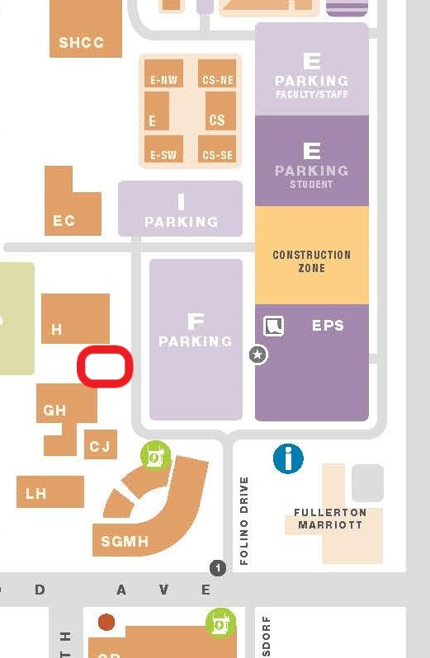
Location

Slide 7
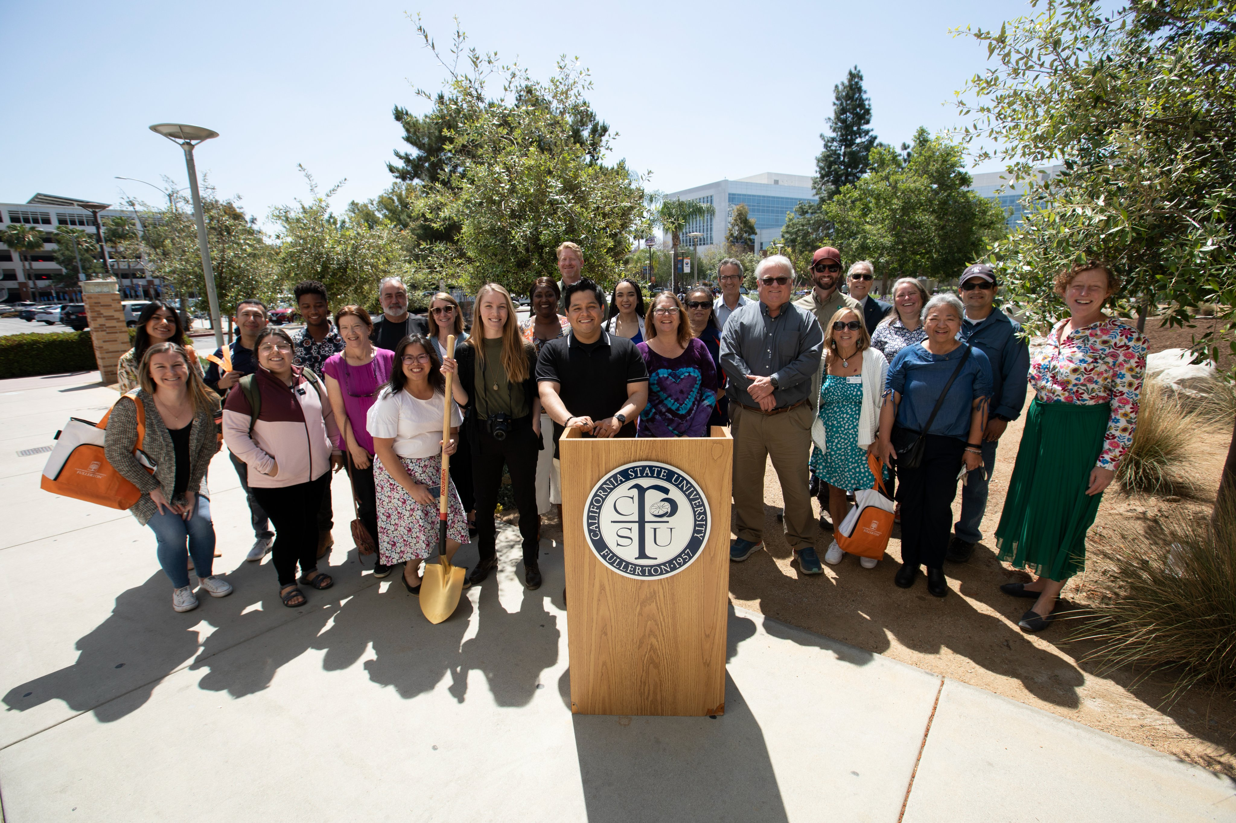
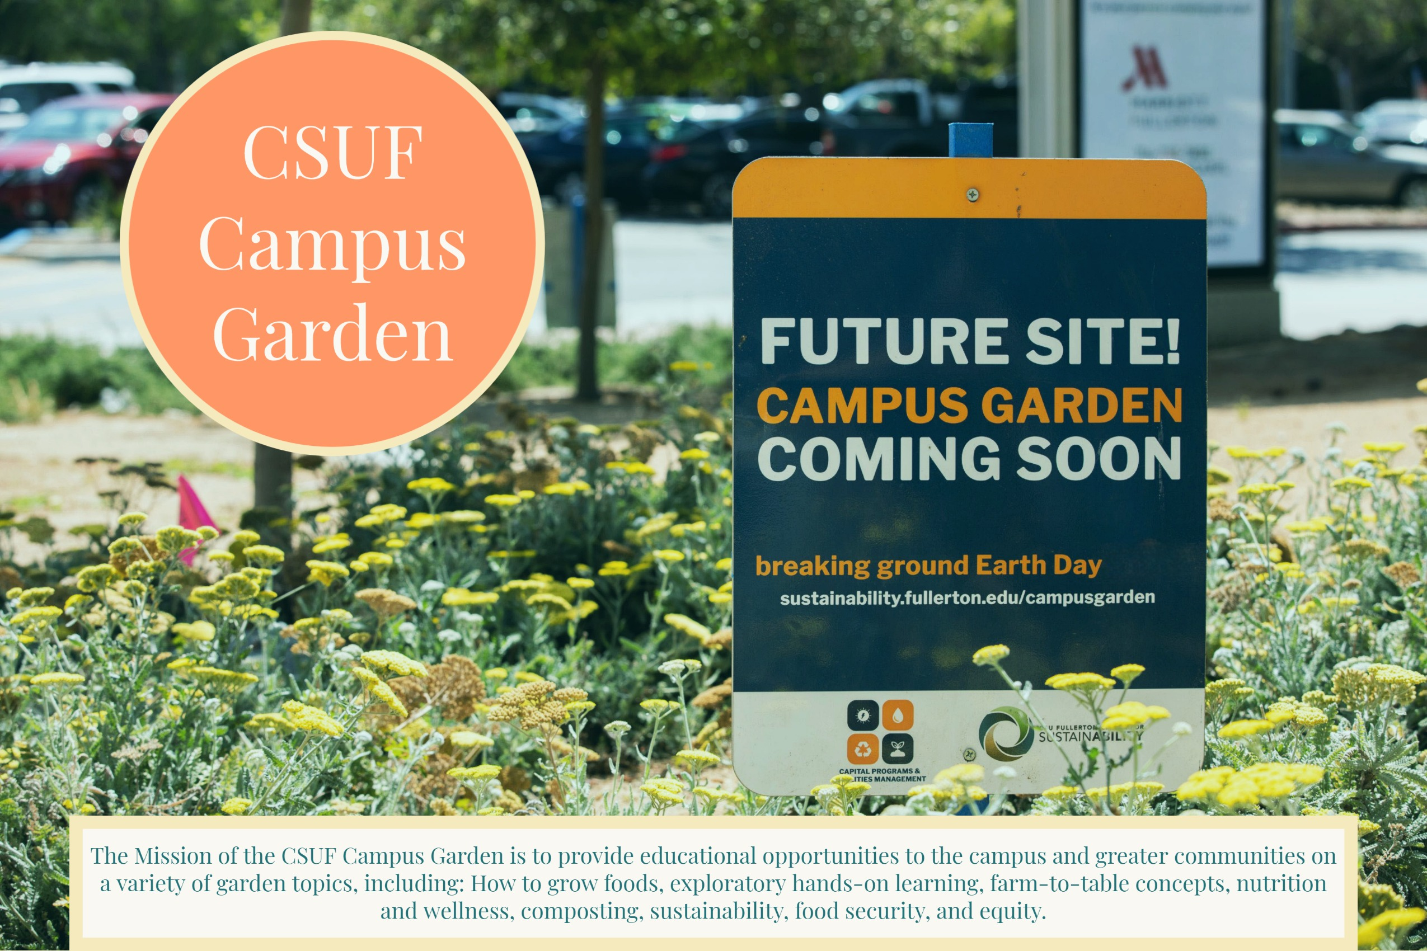
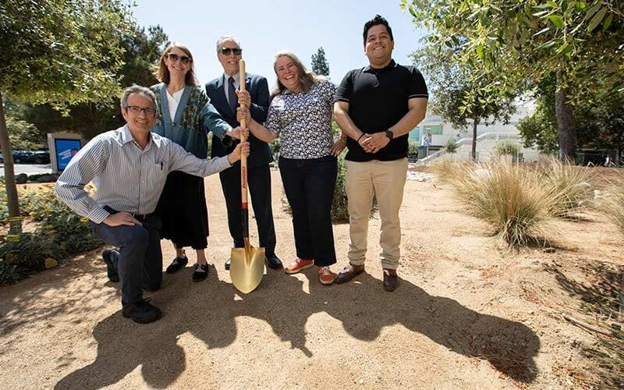
Groundbreaking ceremony
Wed April 21, 2022 12PM
12th Annual CSUF Earth Month

Slide 8
Access
Service-learning classes
Student organizations
Other campus entities (TitanWell and others)

Slide 9
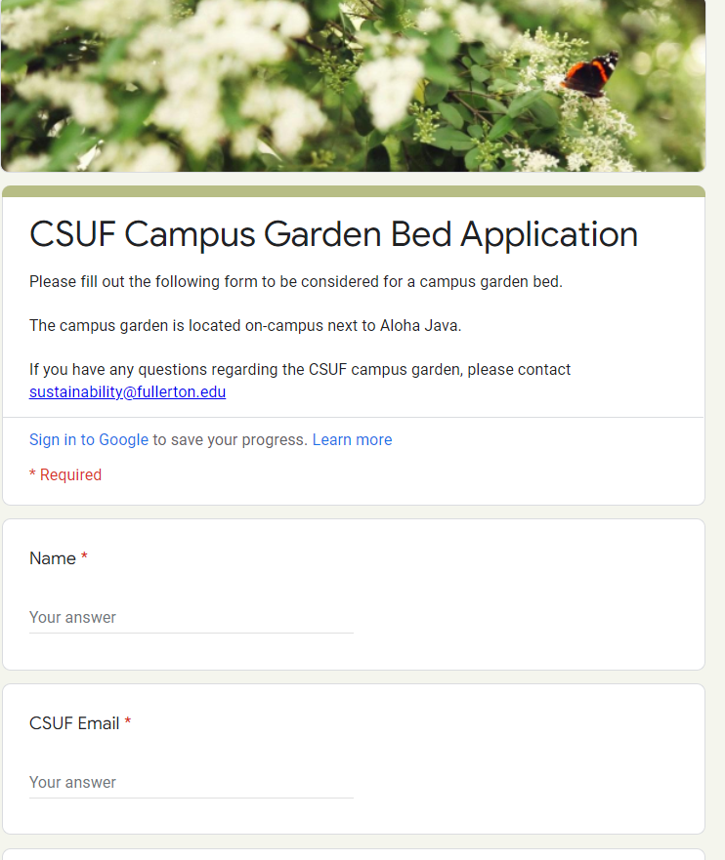
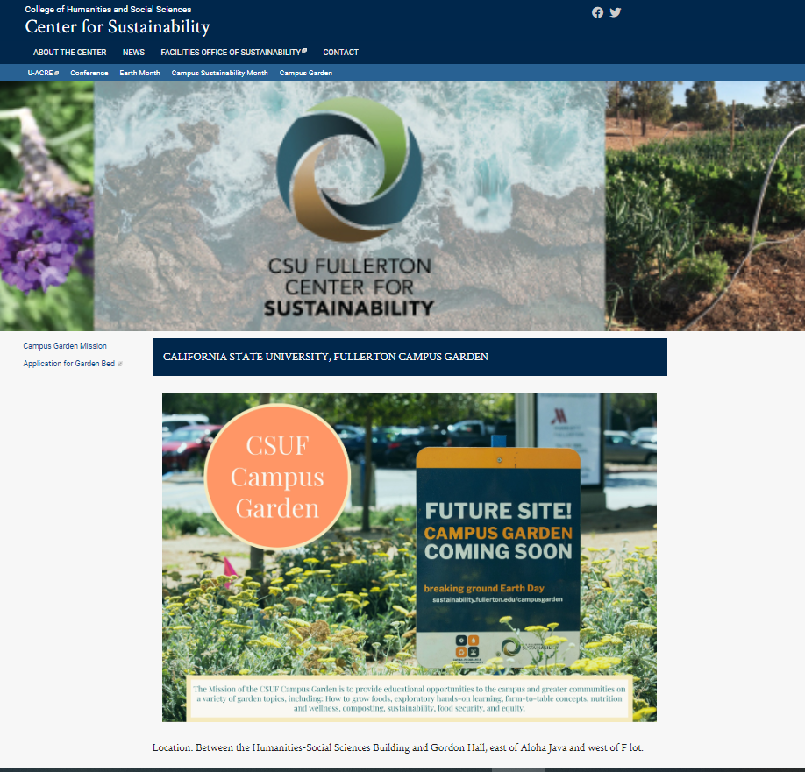
Website
https://sustainability.fullerton.edu/campusgarden/

Slide 11
Phase One Implementation
Assembly
Organization of responsibility for beds
Populating
What is a realistic opening date?
Area improvement
Plantings
Mural

Slide 12
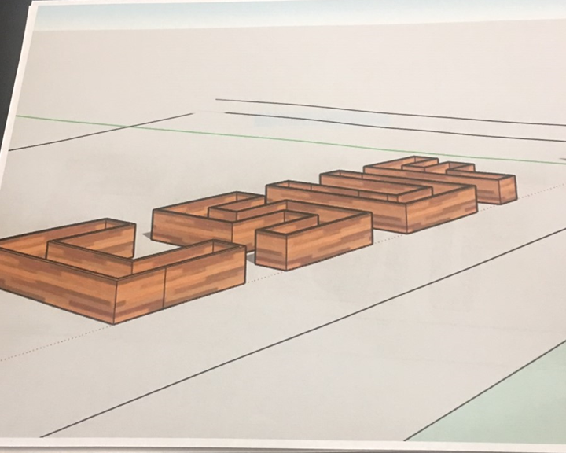
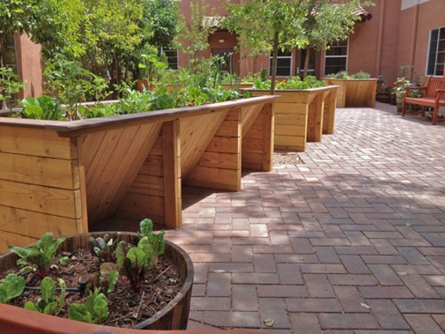
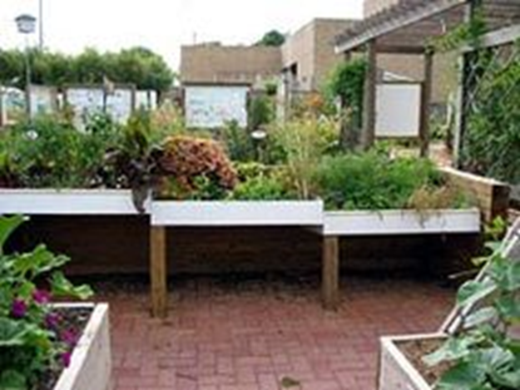
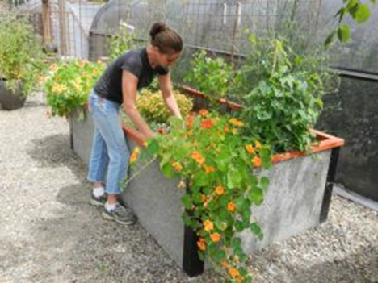
Phase Two
Expansion
Fundraising
Grants?
Other sources?

Slide 13
Volunteers?
Questions, comments, suggestions, feedback?

